Slide 1

Introduction to Data Analysis
Assignment 4
Assignment 4
Assignment 4
2
+
2
+
Introduction to Data Analysis
Assignment 4
SVM And Naïve Bayes
Assignment 4
Name: Kartik Sojitra
(100723768)
Name: Kartik Sojitra
(100723768)

Slide 2

TABLE OF CONTENTS
2
+
2
+
Introduction
Description Of Analysis Conducted
Summery Of Analysis
Comparison Of SVM Algorithm Vs Naïve Bayes Algorithm
Insights and Findings
Recommendation and Justification

Slide 3
Presentation Title Alt 2
2
+
2
+
Introduction
Mr. John Hughes has been analyzing patient data for illness study.
To analyze the data, we are using the Support Vector Machine (SVM) and Naïve Bayes model which is based on categorical variables.
Support Vector Machine (SVM) is best to separate the two hyperplanes and the Naive Bayes model is easy to build and especially useful for very large data sets.
The objective is to import the illnessstudy.csv dataset and run SVM and Naïve Bayes scripts in Jupyter notebook.
SUBTITLE GOES HERE

Slide 4
2
+
2
+
Description Of Analysis
SVM algorithm is Support Vector Machine (SVM) which is based on categorical variables.
SVM Model can create a high accuracy for the model and it is a powerful and flexible class of supervised algorithms for both classification and regression..
The purpose of SVM is to separate the given dataset into the best possible way and determine the distance between either nearest points that is known as the margin.
The objective is to select a hyperplane with the maximum possible margin between support vectors in the illnessstudy.csv dataset.
Continue…

Slide 5
2
+
2
+
The accuracy between the y_test and y_pred which is 0.96.
The recall value, f1 score and precision value is more than 95% which demonstrate that SVM is very good to predict illness.
The model is correctly classified by the confusion matrix as its true negative value 69 and true positive value 40.

Slide 6
2
+
2
+
Summery Of Analysis
Load libraries
Load data - illnessstudy.csv
Create training and test datasets
Scale the data
Script for SVM and NB algorithm

Slide 7
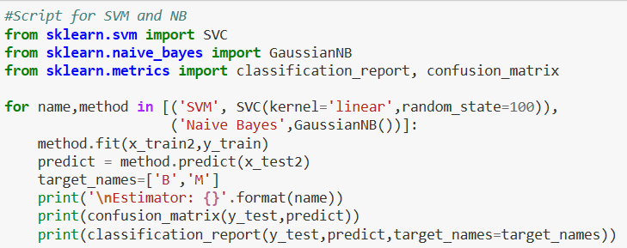
Comparison Of SVM Vs NB Algorithm
2
NBNNB
+
2
+
SVM
SVM works well with clear margin of separation and It is effective in high dimensional spaces.
It is effective in cases where number of dimensions is greater than the number of samples and It uses a subset of training points in the support vector.
It doesn’t perform well, when we have large data set because the required training time is higher.
NB
NB algorithm is easy and fast to predict class of test data set and perform well in multi class prediction.
It perform well in case of categorical input variables compared to numerical variables.
Naïve Bayes is also known as a bad estimator and it is the assumption of independent predictors.
Naive Bayes classifier performs better compare to other models and it need less training data.

Slide 8
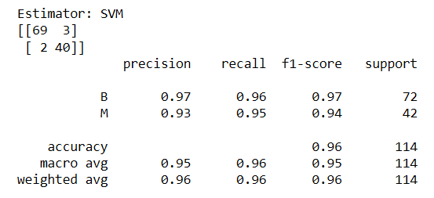
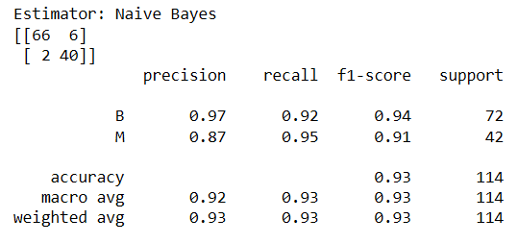
Insights and Findings
2
+
To evaluate an algorithm, we used a confusion matrix, precision and recall, besides, confusion matrix and classification methods are used to find the scores.
Accuracy of this model is 0.96 which demonstrates that SVM model is very good to predict malignant or Benign.
In SVM model, probability of individual has Benign is 96% and Malignant is 95% from recall score.
In Naïve Bayes model, accuracy is 93% which mean it is good to predict malignant or Benign.
In NB model, probability of individual has Benign is 92% and Malignant is 95% from f1-score that demonstrates NB model is less powerful than the SVM model.
2
+

Slide 9
Recommendation and Justification
2
+
2
+
Comparatively, Support Vector Machine model shows high accuracy rather than Naïve Bayes model i.e 96%.
SVM and NB models are good to predict individual has Malignant or Benign as both has higher recall and precision score.
Mr. John Hughes should not add any variable or make any change because both models are very good and accurate.

Slide 10
Thank
2
+
Thank You..

